Slide 1

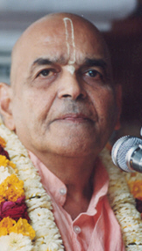
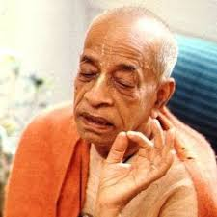
संकट से कैसे निपटें ? How to handle distress ?
Based on Bhagavat Saptah Lecture by HH Maha Vishnu Goswami Maharaj in Sydney

Slide 2
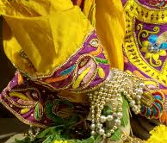
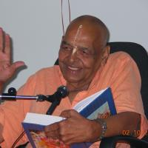
Recap
Duty in this age
Lead simple life
Don’t waste time in mental concoction
Utilize time in serious study of Bhagavatam
Medicine for this age
Hear, Study and Contemplate
Heart is meant for Krishna
Solution to our dissatisfaction
Spirit cannot be happy with matter.
Glorify Lord Sri Krishna
What is Real Wealth
Pleasing Krishna pleases everyone
Laxmi or Durga
Remembrance of Krishna

Slide 3
पुनरावृत्ति
इस युग में कर्तव्य
सादा जीवन जिए
मानसिक मनगढ़ंत में समय बर्बाद न करें
भागवतम् के गंभीर अध्ययन करें
इस युग के लिए दवा
तच्छृण्वन् सुपठन् विचारणपरो [SB 12.13.18]
हृदय कृष्ण के लिए है
हमारे असंतोष का समाधान
आत्मा पदार्थ से खुश नहीं हो सकती
भगवान कृष्ण की महिमा करें
वास्तविक धन क्या है
यास्मीन तुष्टे जगत् तुष्टे
लक्ष्मी या दुर्गा
कृष्ण का स्मरण

Slide 4
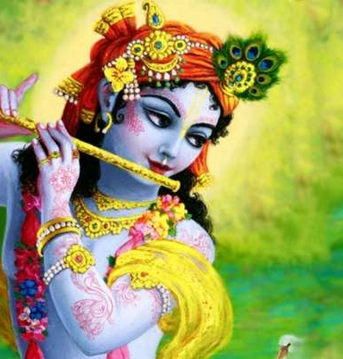
Real Wealth: Remembrance of Krishna
Kaliyuga stayed where there was gold, but because of Parikshit Maharaja’s best rule, he was not that powerful.
As soon as Kåñëa left the planet, then Kaliyuga became rampant.
Even now, in our life, if we add Kåñëa, then we can save ourselves from these difficulties. This is the main thing
0000000 = Zero
1000000 – million

Slide 5
असली धन: कृष्ण का स्मरण
कलियुग जहां सोना था, वहां रुक गया, लेकिन परीक्षित महाराजा के सर्वोत्तम शासन के कारण, वह शक्तिशाली नहीं था
जैसे ही कृष्ण ने ग्रह छोड़ा, तब कलियुग व्याप्त हो गया।
अब भी, हमारे जीवन में, अगर हम कृष्ण को जोड़ते हैं, तो हम इन कठिनाइयों से खुद को बचा सकते हैं। यह मुख्य बात है
0000000 = शून्य
1000000 - 10 लाख

Slide 6
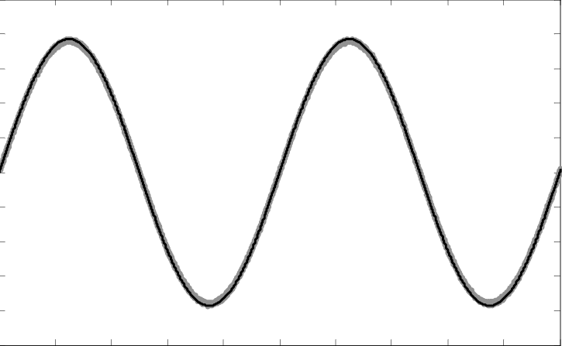
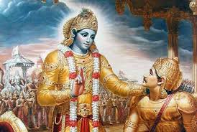


Ups and Downs of Life
Material world is designed to be full of 3 + 4 miseries
How to cope up with ups and downs of life? BG 2.14
Humbly tolerate respecting all
Add Krishna in your life (100,000)
Everything happens according to His plan [SB 1.9.16 / 1.8.19]

Slide 7
जीवन के उतार चढ़ाव
भौतिक दुनिया को 3 + 4 दुखों से भरा बनाया गया है
जीवन के उतार-चढ़ाव का सामना कैसे करें? BG 2.14
विनम्रतापूर्वक सभी का सम्मान करते हैं
अपने जीवन में कृष्ण को जोड़ें (1,00,000)
सब कुछ उसकी योजना के अनुसार होता है [SB 1.9.16 / 1.8.19]

Slide 8
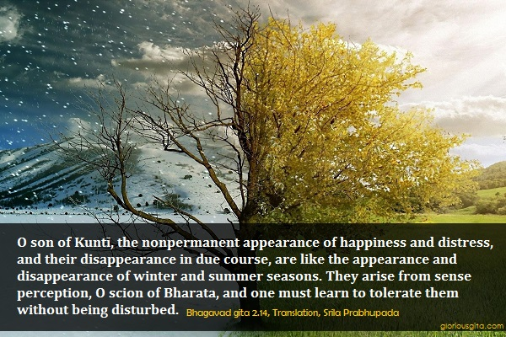

Slide 9
Tolerance
मात्रास्पर्शास्तु कौन्तेय शीतोष्णसुखदुःखदाः । आगमापायिनोऽनित्यास्तांस्तितिक्षस्व भारत ॥ १४ ॥
mātrā-sparśās tu kaunteya śītoṣṇa-sukha-duḥkha-dāḥ āgamāpāyino ’nityās tāṁs titikṣasva bhārata
mātrā-sparśāḥ — sensory perception; tu — only; kaunteya — O son of Kuntī; śīta — winter; uṣṇa — summer; sukha — happiness; duḥkha — and pain; dāḥ — giving; āgama — appearing; apāyinaḥ — disappearing; anityāḥ — nonpermanent; tān — all of them; titikṣasva — just try to tolerate; bhārata — O descendant of the Bharata dynasty.

Slide 10
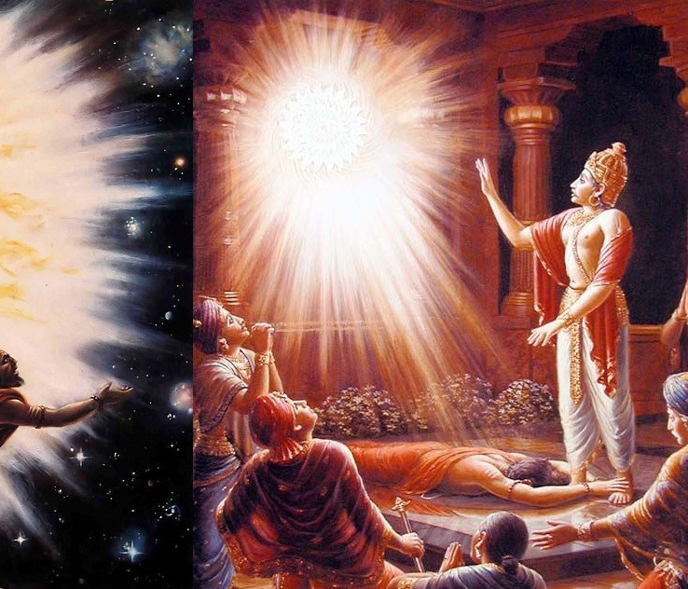
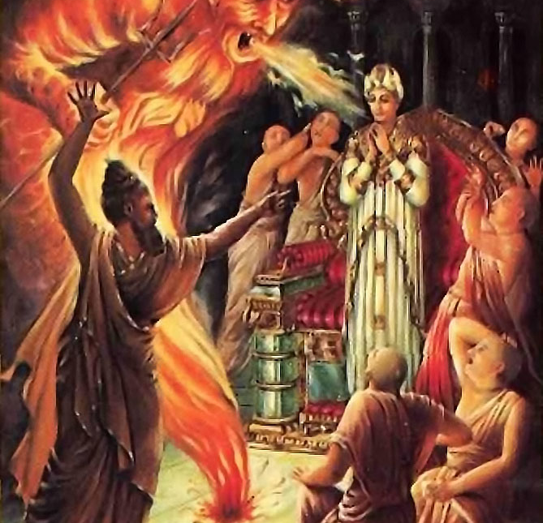
Happiness increases when karma improves
Durvasa muni insulted Ambarish Maharaj
Where there is bhakti, all good qualities reside. [SB 5.18.12]
Do not get dirty by the undue influence of the three modes of material nature. Particularly the mode of ignorance.

Slide 11
कर्म में सुधार होने पर खुशियाँ बढ़ती हैं
दुर्वासा मुनि ने अंबरीश महाराज का अपमान किया
जहां भक्ति होती है, वहां सभी अच्छे गुणों का वास होता है। [SB 5.18.12]
भौतिक प्रकृति के तीन गुन के अनुचित प्रभाव से गंदे न हों। खासतौर पर तमो गुन।

Slide 12
यस्यास्ति भक्तिर्भगवत्यकिञ्चना सर्वैर्गुणैस्तत्र समासते सुरा: । हरावभक्तस्य कुतो महद्गुणा मनोरथेनासति धावतो बहि: ॥ १२ ॥
All the demigods and their exalted qualities, such as religion, knowledge and renunciation, become manifest in the body of one who has developed unalloyed devotion for the Supreme Personality of Godhead, Vāsudeva. On the other hand, a person devoid of devotional service and engaged in material activities has no good qualities. Even if he is adept at the practice of mystic yoga or the honest endeavor of maintaining his family and relatives, he must be driven by his own mental speculations and must engage in the service of the Lord’s external energy. How can there be any good qualities in such a man? [SB 5.18.12]

Slide 13
Synonyms
yasya — of whom; asti — there is; bhaktiḥ — devotional service; bhagavati — to the Supreme Personality of Godhead; akiñcanā — without any motive; sarvaiḥ — with all; guṇaiḥ — good qualities; tatra — there (in that person); samāsate — reside; surāḥ — all the demigods; harau — unto the Supreme Personality of Godhead; abhaktasya — of a person who is not devoted; kutaḥ — where; mahat-guṇāḥ — good qualities; manorathena — by mental speculation; asati — in the temporary material world; dhāvataḥ — who is running; bahiḥ — outside.

Slide 14
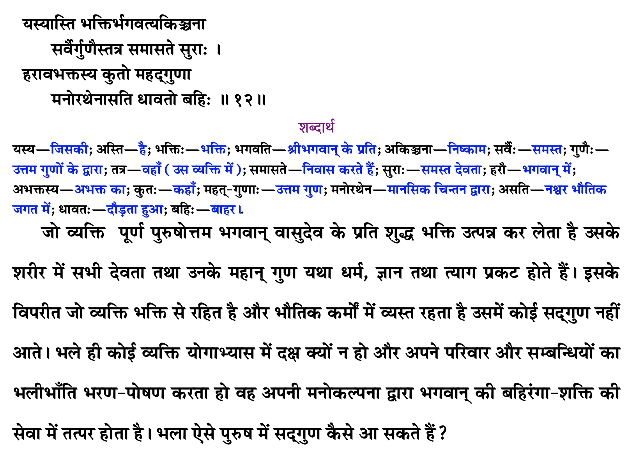

Slide 15
Reviving our original quality
As explained in the next verse, Kṛṣṇa is the original source of all living entities. This is confirmed in Bhagavad-gītā (15.7), wherein Kṛṣṇa says:
mamaivāṁśo jīva-loke jīva-bhūtaḥ sanātanaḥ manaḥ ṣaṣṭhānīndriyāṇi prakṛti-sthāni karṣati
“The living entities in this conditioned world are My eternal, fragmental parts. Due to conditioned life, they are struggling very hard with the six senses, which include the mind.” All living entities are part and parcel of Kṛṣṇa, and therefore when they revive their original Kṛṣṇa consciousness, they possess all the good qualities of Kṛṣṇa in a small quantity. When one engages himself in the nine processes of devotional service (śravaṇaṁ kīrtanaṁ viṣṇoḥ smaraṇaṁ pāda-sevanam/ arcanaṁ vandanaṁ dāsyaṁ sakhyam ātma-nivedanam), one’s heart becomes purified, and he immediately understands his relationship with Kṛṣṇa. He then revives his original quality of Kṛṣṇa consciousness.

Slide 16
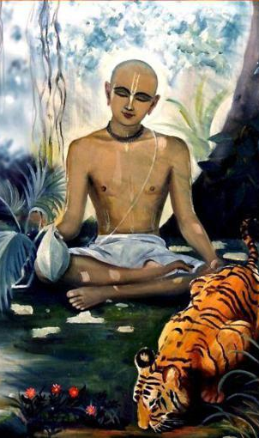
Qualities of Devotee Haridas Thakur
In the Ādi-līlā of Caitanya-caritāmṛta, Chapter Eight, there is a description of some of the qualities of devotees. For example, Śrī Paṇḍita Haridāsa is described as being very well-behaved, tolerant, peaceful, magnanimous and grave. In addition, he spoke very sweetly, his endeavors were very pleasing, he was always patient, he respected everyone, he always worked for everyone’s benefit, his mind was free of duplicity, and he was completely devoid of all malicious activities. These are all originally qualities of Kṛṣṇa, and when one becomes a devotee they automatically become manifest. Śrī Kṛṣṇadāsa Kavirāja, the author of Caitanya-caritāmṛta, says that all good qualities become manifest in the body of a Vaiṣṇava and that only by the presence of these good qualities can one distinguish a Vaiṣṇava from a non-Vaiṣṇava.

Slide 17
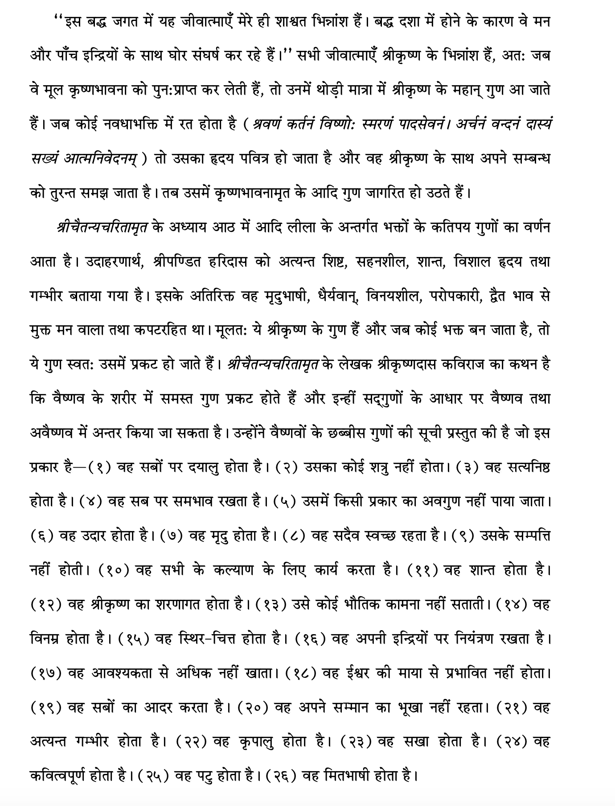

Slide 18
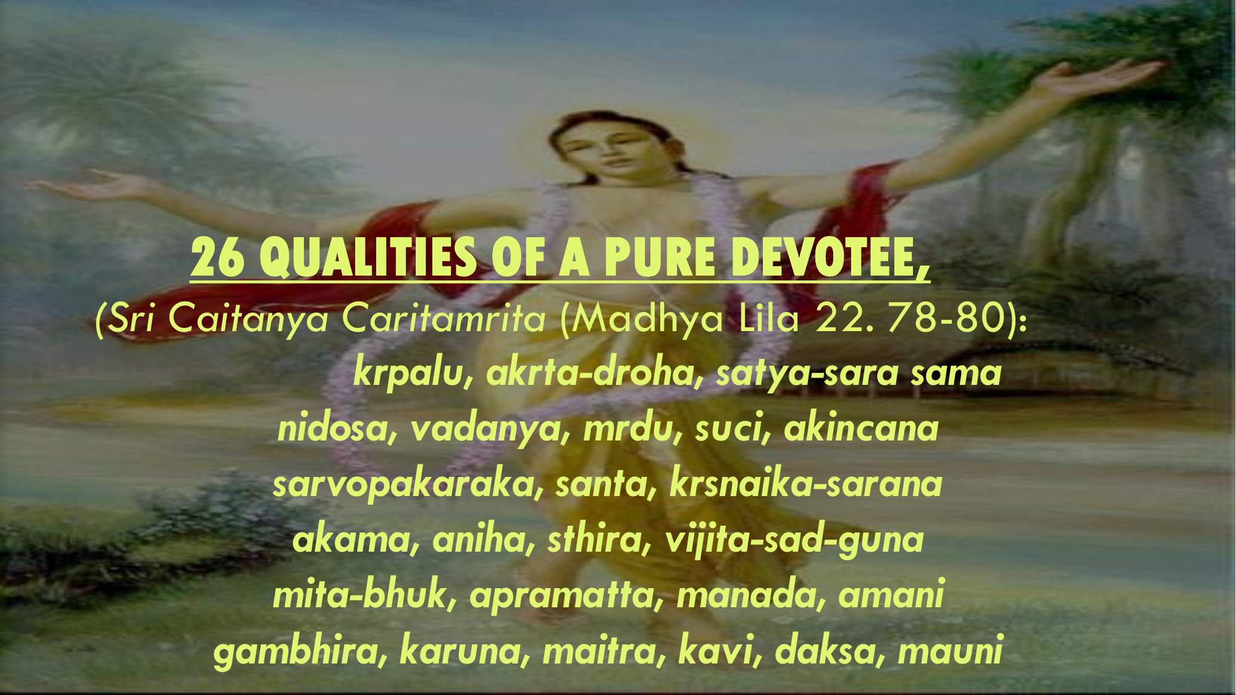
Twenty-six good qualities of a Vaiṣṇava
Kṛṣṇadāsa Kavirāja lists the following twenty-six good qualities of a Vaiṣṇava:
(1) He is very kind to everyone. (2) He does not make anyone his enemy. (3) He is truthful. (4) He is equal to everyone.
(5) No one can find any fault in him. (6) He is magnanimous. (7) He is mild. (8) He is always clean. (9) He is without possessions.
(10) He works for everyone’s benefit. (11) He is very peaceful. (12) He is always surrendered to Kṛṣṇa.
(13) He has no material desires. (14) He is very meek. (15) He is steady. (16) He controls his senses.
(17) He does not eat more than required. (18) He is not influenced by the Lord’s illusory energy. (19) He offers respect to everyone. (20) He does not desire any respect for himself.
(21) He is very grave. (22) He is merciful. (23) He is friendly. (24) He is poetic. (25) He is expert. (26) He is silent.

Slide 19
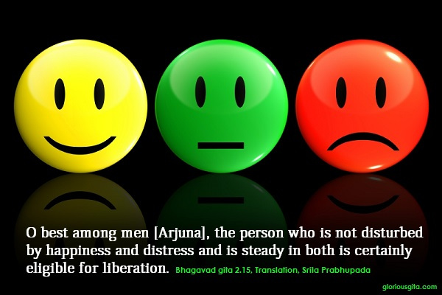

Slide 20
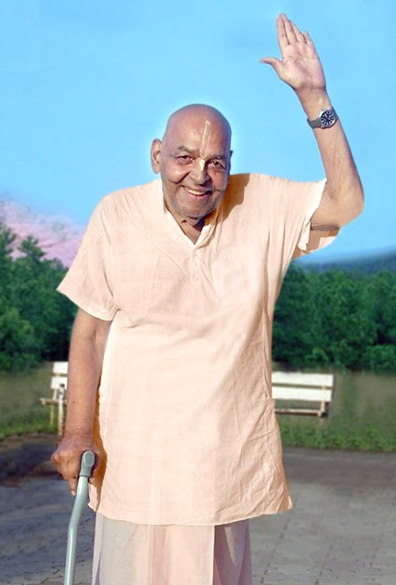
Patience leads to liberation
यं हि न व्यथयन्त्येते पुरुषं पुरुषर्षभ । समदुःखसुखं धीरं सोऽमृतत्वाय कल्पते ॥ १५ ॥
yaṁ hi na vyathayanty ete puruṣaṁ puruṣarṣabha sama-duḥkha-sukhaṁ dhīraṁ so ’mṛtatvāya kalpate
yam — one to whom; hi — certainly; na — never; vyathayanti — are distressing; ete — all these; puruṣam — to a person; puruṣa-ṛṣabha — O best among men; sama — unaltered; duḥkha — in distress; sukham — and happiness; dhīram — patient; saḥ — he; amṛtatvāya — for liberation; kalpate — is considered eligible.
O best among men [Arjuna], the person who is not disturbed by happiness and distress and is steady in both is certainly eligible for liberation.[BG 2.15]

Slide 21
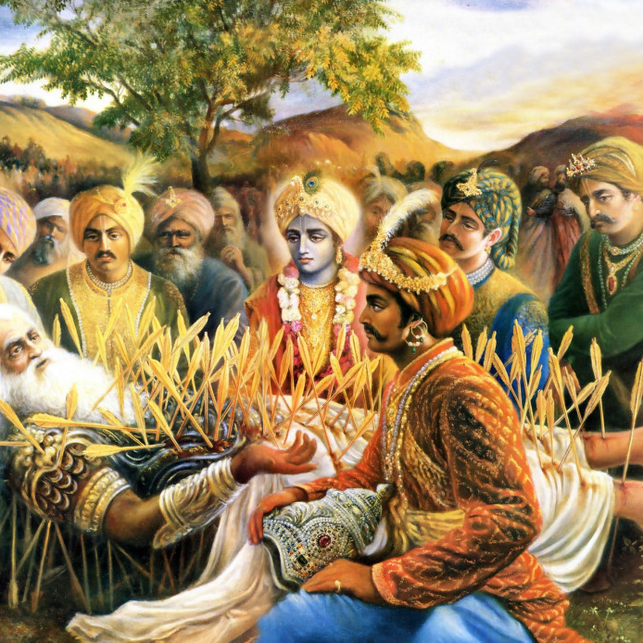
No one knows His plan
न ह्यस्य कर्हिचिद्राजन् पुमान् वेद विधित्सितम् । यद्विजिज्ञासया युक्ता मुह्यन्ति कवयोऽपि हि ॥ १६ ॥
na hy asya karhicid rājan pumān veda vidhitsitam yad vijijñāsayā yuktā muhyanti kavayo ’pi hi
na — never; hi — certainly; asya — His; karhicit — whatsoever; rājan — O King; pumān — anyone; veda — knows; vidhitsitam — plan; yat — which; vijijñāsayā — with exhaustive inquiries; yuktāḥ — being engaged; muhyanti — bewildered; kavayaḥ — great philosophers; api — even; hi — certainly.
O King, no one can know the plan of the Lord [Śrī Kṛṣṇa]. Even though great philosophers inquire exhaustively, they are bewildered.[SB 1.19.16]

Slide 22
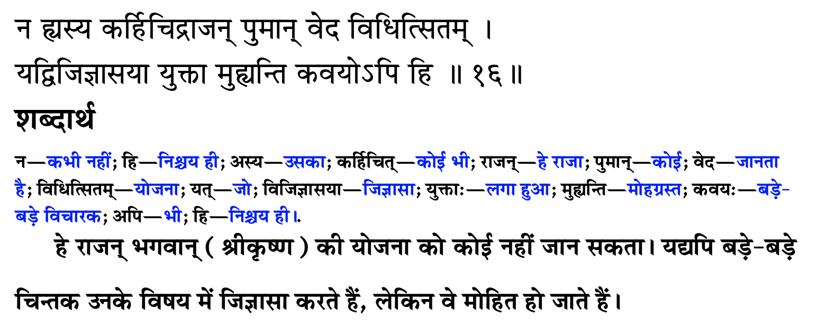
उसकी योजना कोई नहीं जानता

Slide 23
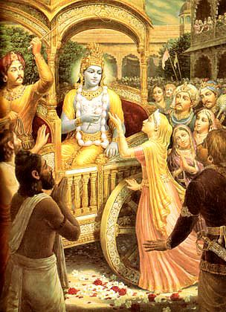
The invisible actor
मायाजवनिकाच्छन्नमज्ञाधोक्षजमव्ययम् । न लक्ष्यसे मूढद‍ृशा नटो नाट्यधरो यथा ॥ १९ ॥
māyā-javanikācchannam ajñādhokṣajam avyayam na lakṣyase mūḍha-dṛśā naṭo nāṭyadharo yathā
māyā — deluding; javanikā — curtain; ācchannam — covered by; ajñā — ignorant; adhokṣajam — beyond the range of material conception (transcendental); avyayam — irreproachable; na — not; lakṣyase — observed; mūḍha-dṛśā — by the foolish observer; naṭaḥ — artist; nāṭya-dharaḥ — dressed as a player; yathā — as.
Being beyond the range of limited sense perception, You are the eternally irreproachable factor covered by the curtain of deluding energy. You are invisible to the foolish observer, exactly as an actor dressed as a player is not recognized.[SB 1.8.19]

Slide 24
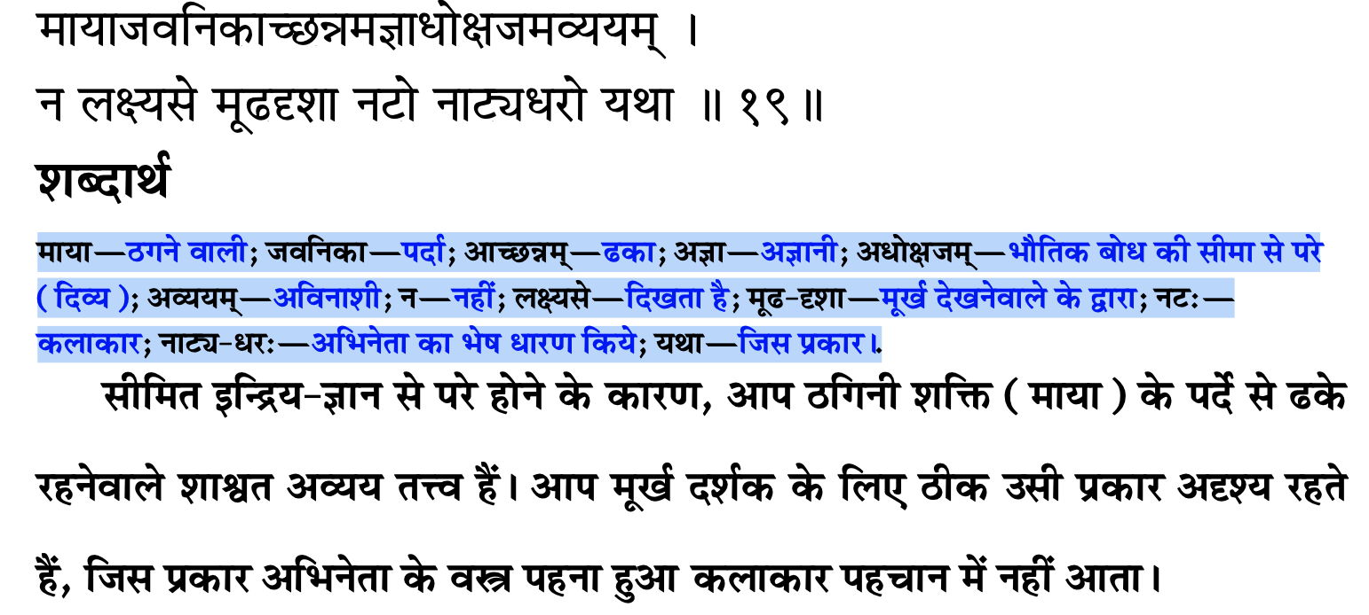
अदृश्य अभिनेता

Slide 25
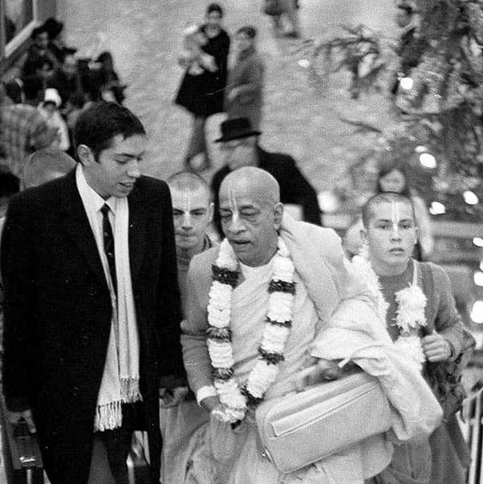
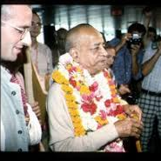
Blame yourself not others – See only Krishna
बहूनां जन्मनामन्ते ज्ञानवान्मां प्रपद्यते । वासुदेव: सर्वमिति स महात्मा सुदुर्लभ: ॥ १९ ॥
bahūnāṁ janmanām ante jñānavān māṁ prapadyate vāsudevaḥ sarvam iti sa mahātmā su-durlabhaḥ
bahūnām — many; janmanām — repeated births and deaths; ante — after; jñāna-vān — one who is in full knowledge; mām — unto Me; prapadyate — surrenders; vāsudevaḥ — the Personality of Godhead, Kṛṣṇa; sarvam — everything; iti — thus; saḥ — that; mahā-ātmā — great soul; su-durlabhaḥ — very rare to see.
After many births and deaths, he who is actually in knowledge surrenders unto Me, knowing Me to be the cause of all causes and all that is. Such a great soul is very rare.[BG 7.19]

Slide 26
Points to remember
Source of all good qualities is ……
Where there is …… all good qualities reside
Real doer is …..
Everything happens according to ….. plans.
If we develop habit of seeing Krishna in all circumstances, then we will not have ….. towards anybody.
Blame ….. not others

Slide 27
कृपया याद रखें
सभी अच्छे गुणों का स्रोत ….. है
जहां ….. हैं वहां सभी अच्छे गुण निवास करते हैं
असली कर्ता ….. है
सब कुछ ….. की योजना के अनुसार होता है
यदि हम सभी परिस्थितियों में ….. को देखने की आदत विकसित करेंगे तो हम किसी के प्रति ईर्ष्या नहीं करेंगे.
….. को दोष दें दूसरों को नहीं

Slide 28
Eat sparingly and depend on Krishna
One who eats sparingly, eats away the sorrows.
If something happens to the body, then first thing you do is to shut our mouth.
Firstly, don’t talk much or get angry at anyone. When you are not the cause, then why are you angry?

Slide 29
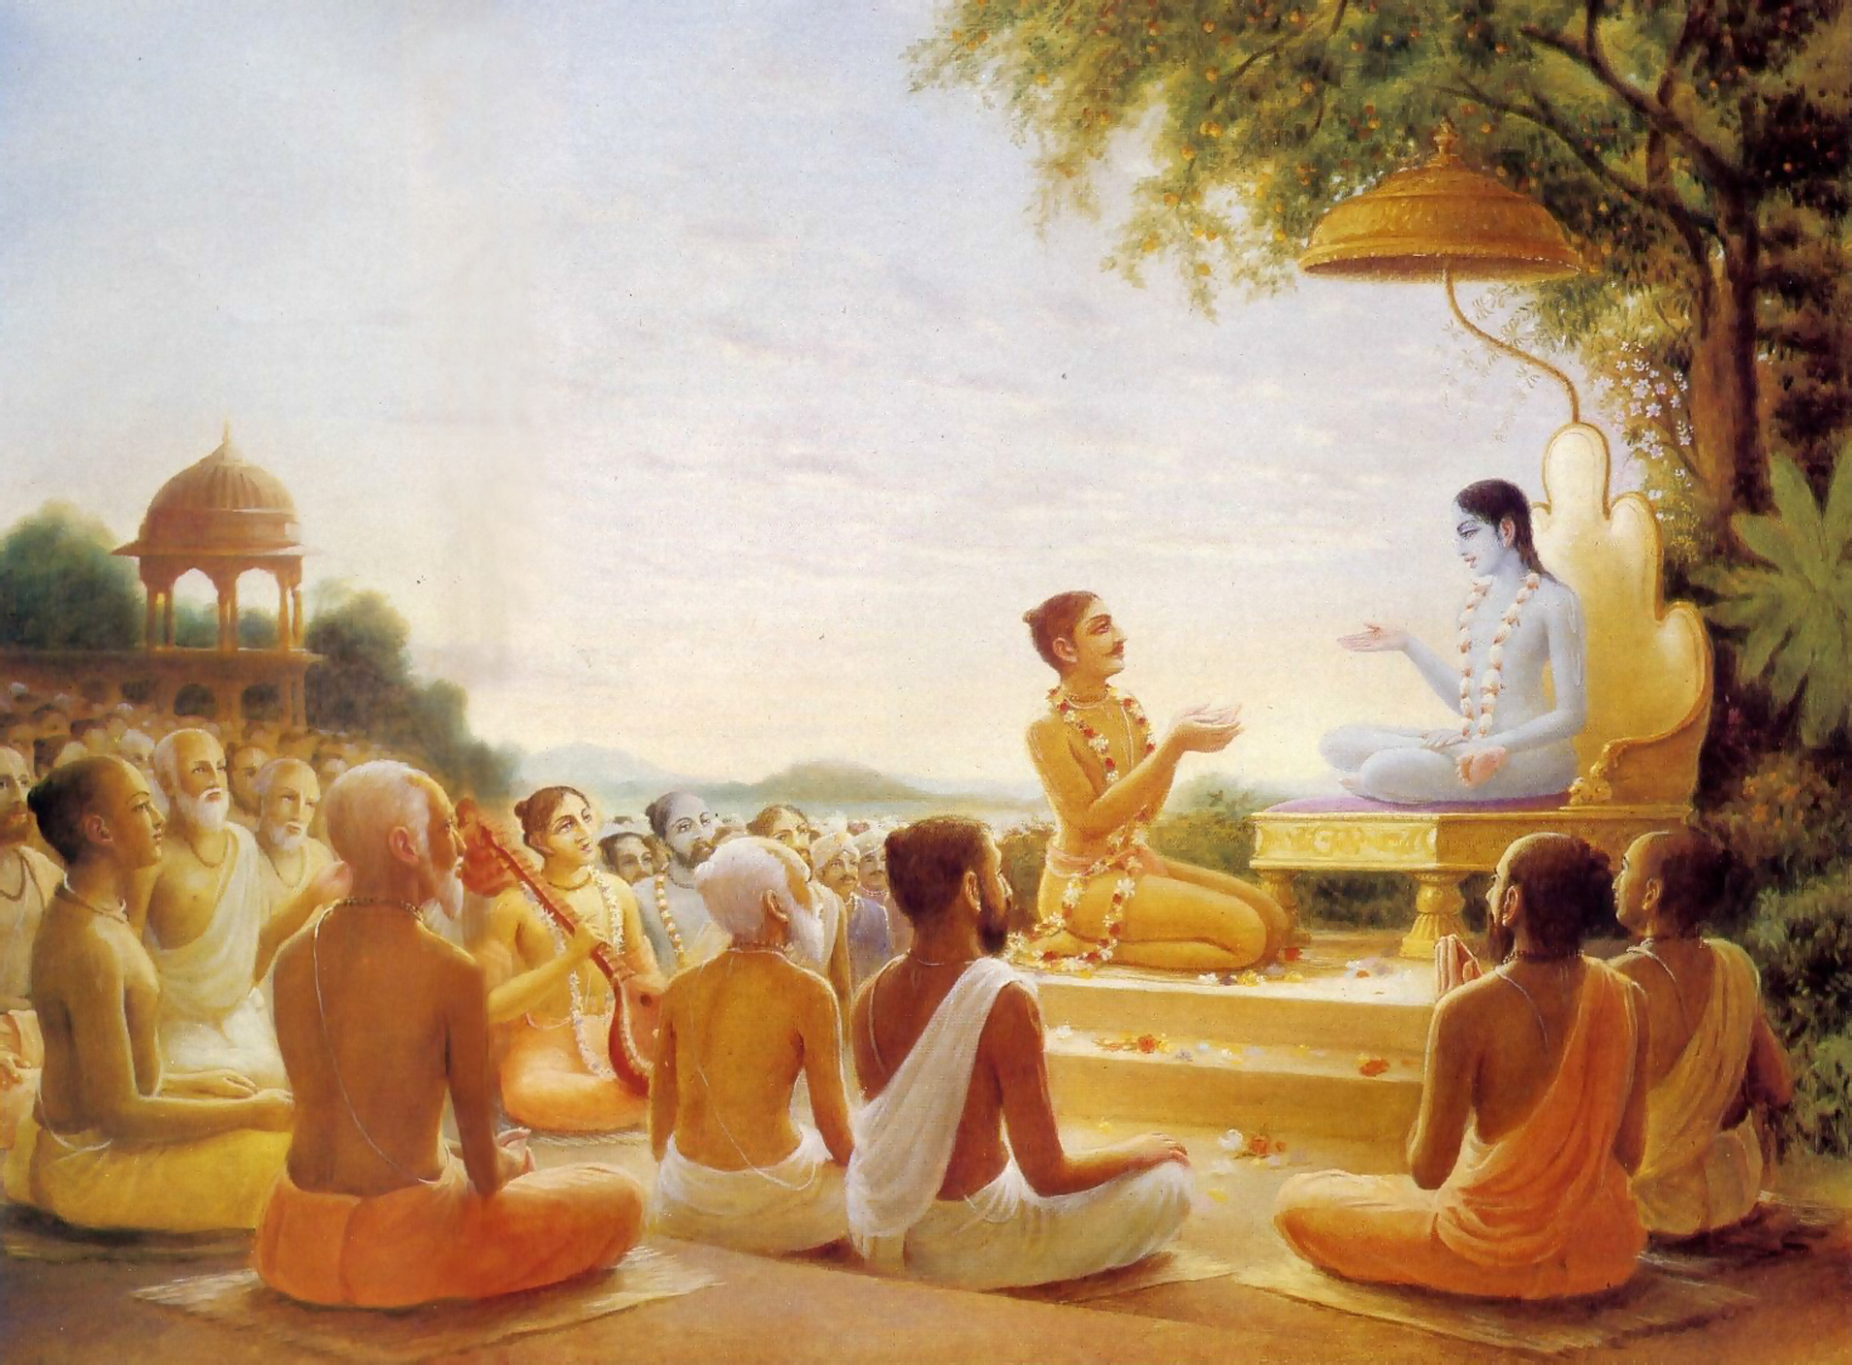
We have to go!
पुनश्च भूयाद्भगवत्यनन्ते
रति: प्रसङ्गश्च तदाश्रयेषु । महत्सु यां यामुपयामि सृष्टिं
मैत्र्यस्तु सर्वत्र नमो द्विजेभ्य: ॥ १६ ॥
punaś ca bhūyād bhagavaty anante
ratiḥ prasaṅgaś ca tad-āśrayeṣu mahatsu yāṁ yām upayāmi sṛṣṭiṁ
maitry astu sarvatra namo dvijebhyaḥ
Again, offering obeisances unto all you brāhmaṇas, I pray that if I should again take my birth in the material world I will have complete attachment to the unlimited Lord Kṛṣṇa, association with His devotees and friendly relations with all living beings. [SB 1.9.16]

Slide 30
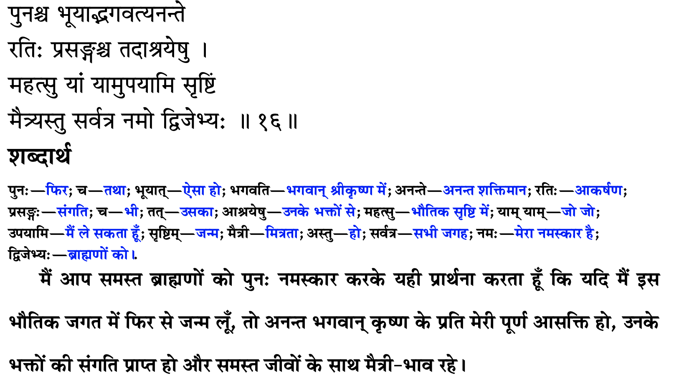
हमने जाना है

Slide 31
Try and God will help you from within
May I be always attracted towards You.
May I have attraction towards those who are surrendered to Kåñëa. May I have association of devotees.
May I have friendly and equal relations with everybody.
You can have very workable relationships with everybody. No intimacy!
dadämi buddhi yogam tam. God gives you intelligence
By creating amicable relationship with everybody, whatever time is saved, should be invested in the pages of Bhägavatam.

Slide 32
कोशिश करो और भगवान तुम्हारे भीतर से मदद करेंगे
मैं हमेशा कृष्ण की ओर आकर्षित रहूं.
क्या मुझे उन लोगों के प्रति आकर्षण है जो कृष्ण के सामने आत्मसमर्पण कर रहे हैं। मुझे भक्तों की संगति करनी चाहिए
मेरा सभी के साथ दोस्ताना और समान संबंध हो.
हर किसी के साथ आपके बहुत काम के रिश्ते हो सकते हैं। कोई अंतरंगता नहीं!
दादामि बुद्धी योगम् तम्। ईश्वर आपको बुद्धि देता है
हर किसी के साथ सौहार्दपूर्ण संबंध बनाकर, जो भी समय बचता है, उसे भावागम के पन्नों में निवेश करना चाहिए।

Slide 33
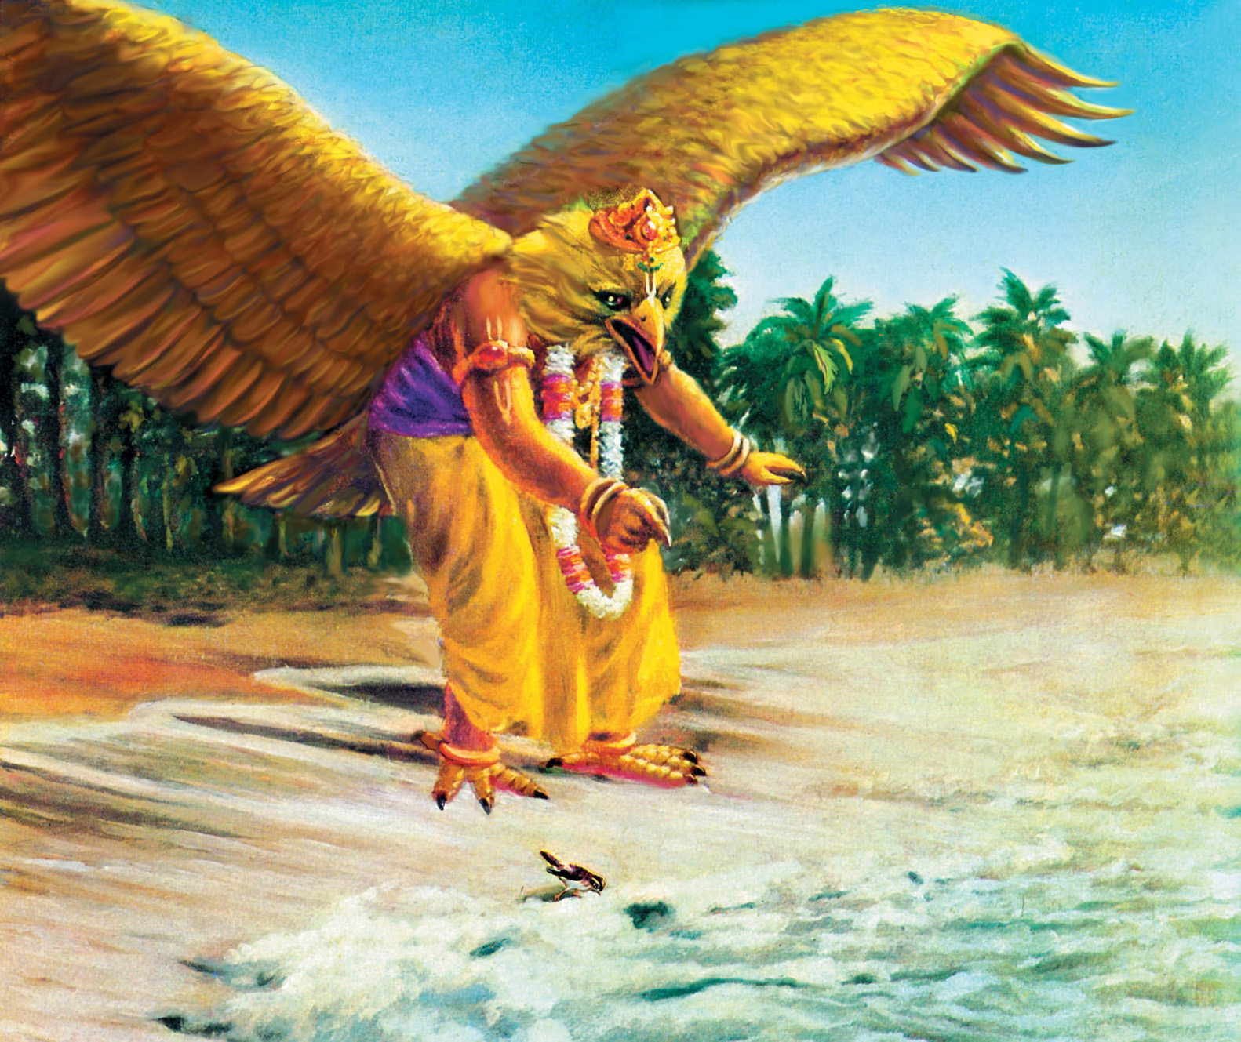

Slide 34
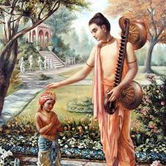
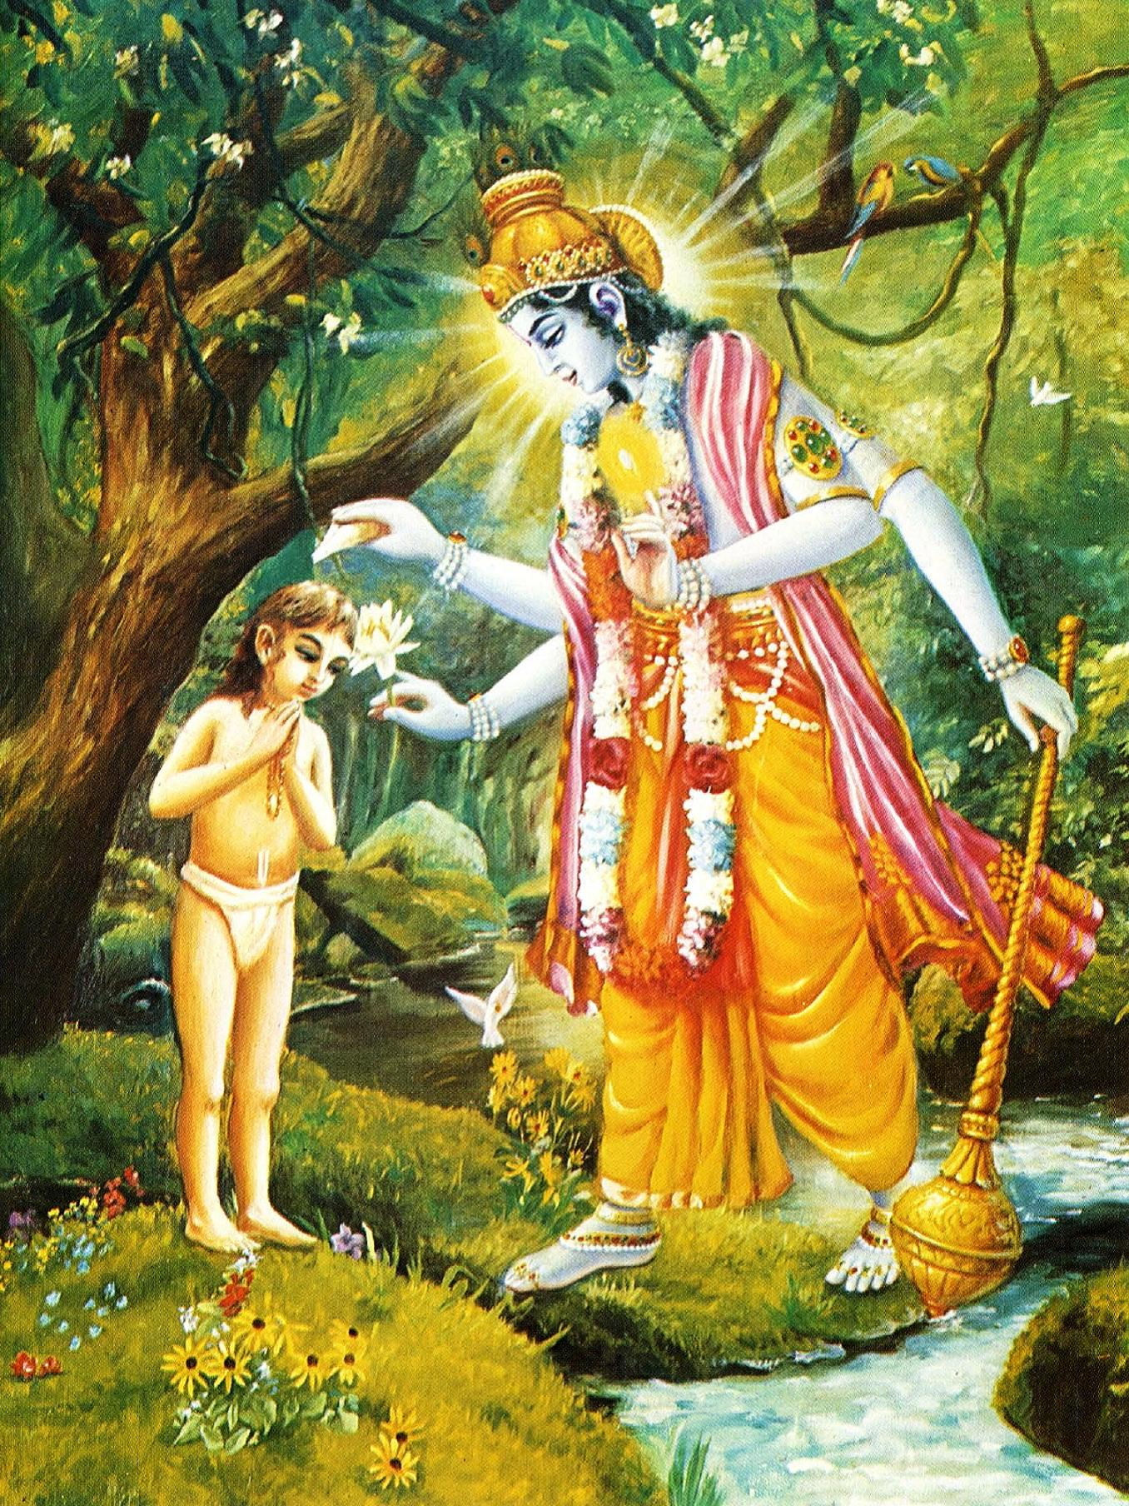
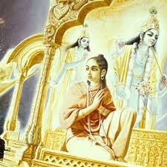
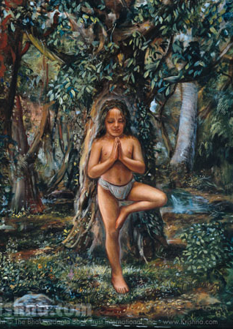
Dhruva Maharaj

Slide 35
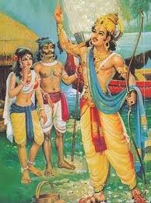
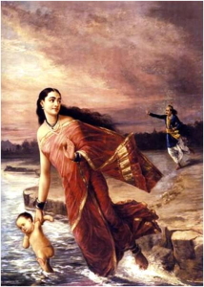
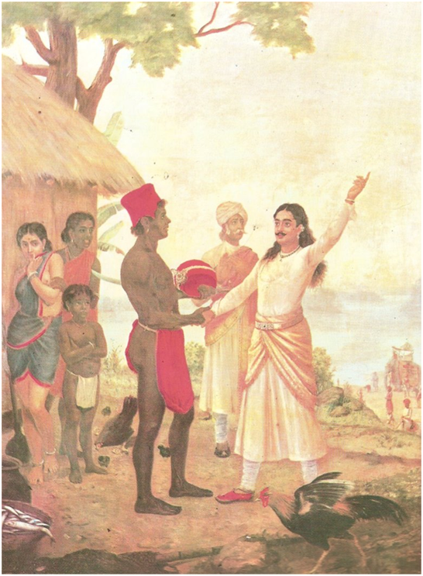
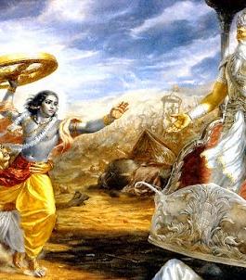
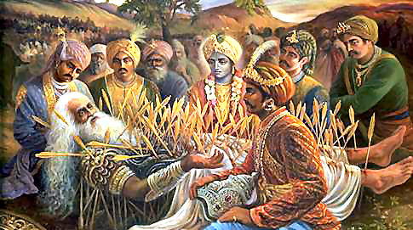
Life of Bhishma Deva

Slide 36
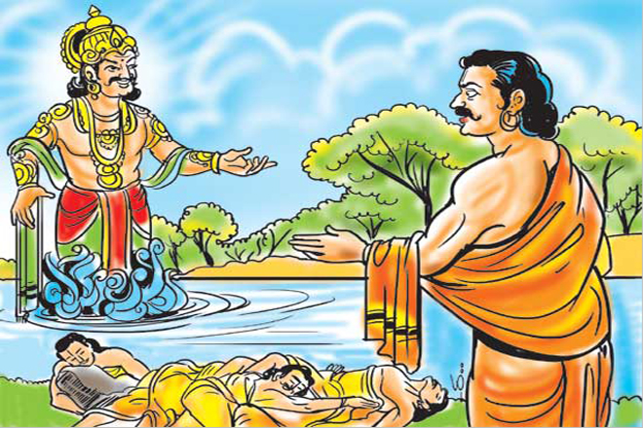
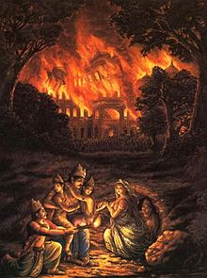
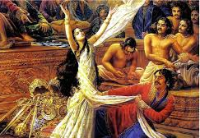
Trials in life of Pandavas
Oh, what terrible sufferings and what terrible injustices you good souls suffer for being the sons of religion personified. You did not deserve to remain alive under those tribulations, yet you were protected by the brāhmaṇas, God and religion.
As far as my daughter-in-law Kuntī is concerned, upon the great General Pāṇḍu’s death, she became a widow with many children, and therefore she suffered greatly. And when you were grown up she suffered a great deal also because of your actions.
In my opinion, this is all due to inevitable time, under whose control everyone in every planet is carried, just as the clouds are carried by the wind. [SB 1.9.12-14]

Slide 37
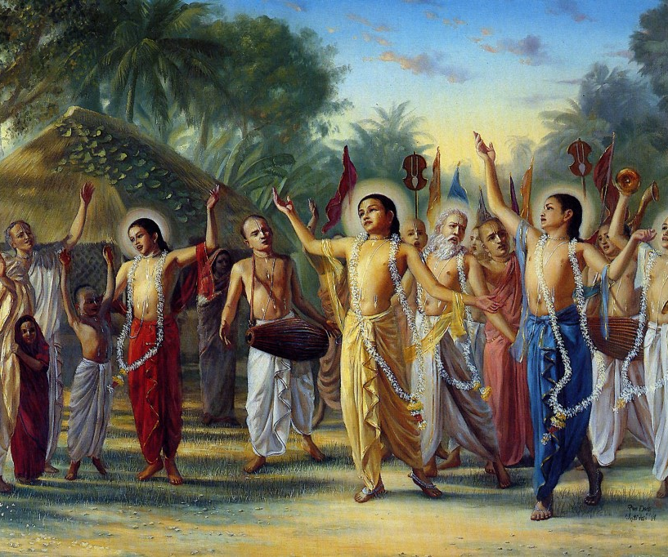
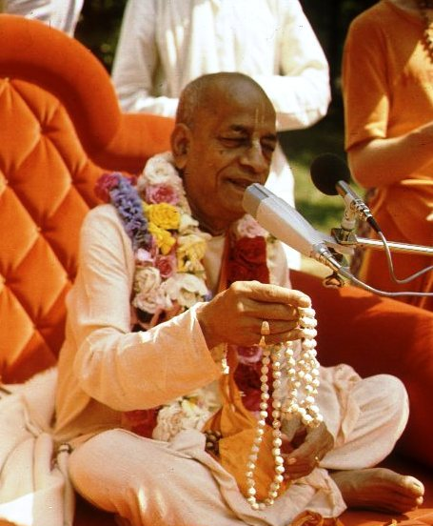
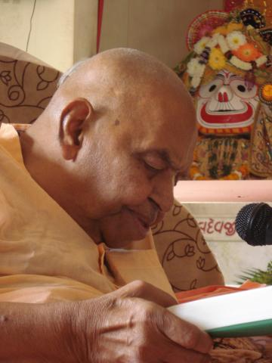
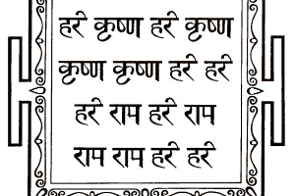
हरे कृष्णा
श्रील प्रभुपाद की जय
गुरुदेव की जय

